Slide 1
Structured Data, Polymorphism, and High-Order Functions

Slide 2
Outline
Definitions of structured data
List, map, option
Definitions of functions
Functions are parameters
Functions are return values

Slide 3
Definitions of Structured Data
Lists of numbers
Partial maps
Natoption
Polymorphic lists
Polymorphic maps
Polymorphic options
Polymorphism

Slide 4

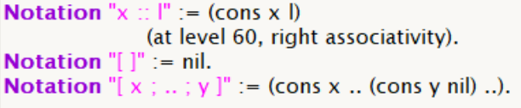
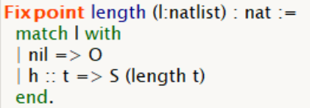
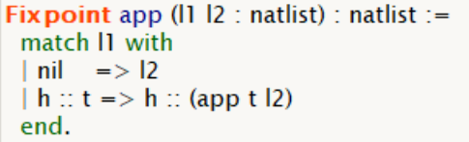

List of Numbers

Slide 5


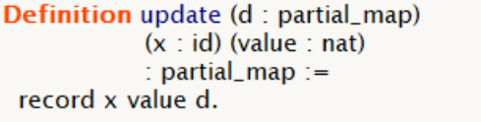
Partial Maps

Slide 6
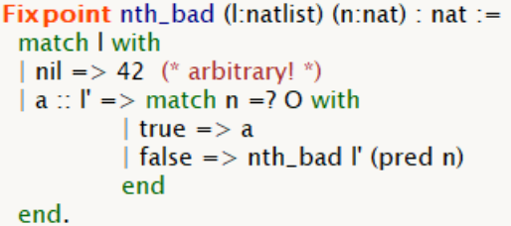

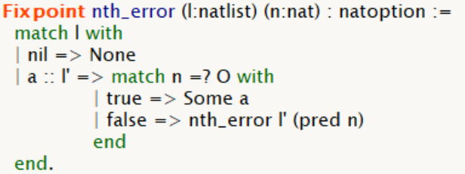
Natoption
whether value 42 actually appears on the input?

Slide 7

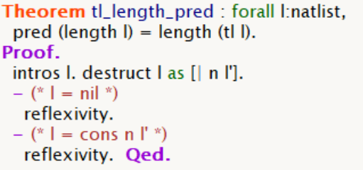
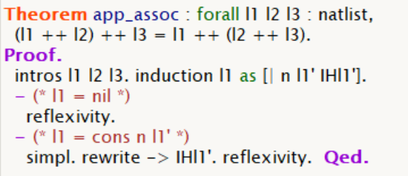
Reasoning About Lists

Slide 8
Definitions of Structured Data
Lists of numbers
Partial maps
Natoption
Polymorphic lists
Polymorphic maps
Polymorphic options
Polymorphism

Slide 9


Polymorphic Lists
Expanding lists of Numbers
Tedious definition
Different constructors for datatypes
Different definitions of manipulating functions
Inductively defined set of lists whose elements are of type X

Slide 10
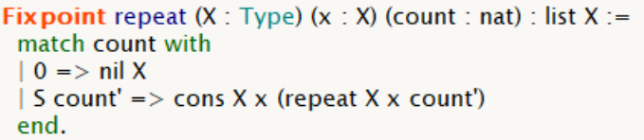
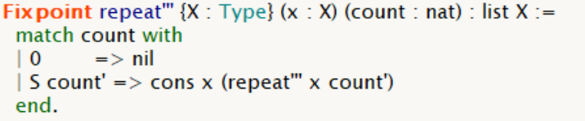
Omitting Type Arguments
Type Annotation Inference
Type Argument Synthesis
Implicit arguments

Slide 11


Implicit Arguments
Arguments:
names of a function (constructor)
its argument names
arguments in {} is implicit

Slide 12
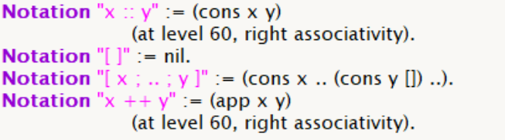

Polymorphic Lists

Slide 13


Explicitly Supplying Type Arguments
Error: Coq doesn't know what type argument to supply to nil

Slide 14


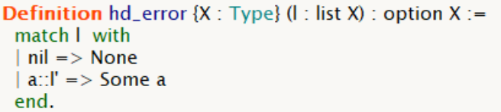
Polymorphic Options
Expanding natoption

Slide 15
Outline
Definitions of structured data
List, map, option
Definitions of functions
Functions are data in functional programming
Functions are parameters
Functions are return values

Slide 16
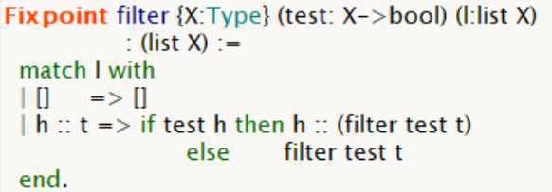
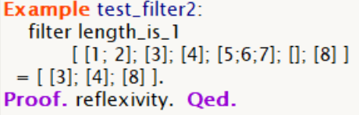
Higher-Order Functions
Functions are parameters of other functions

Slide 17
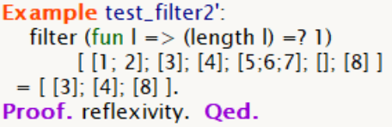
Anonymous Functions

Slide 18
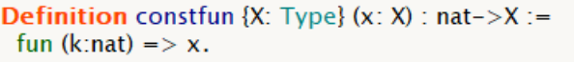

Functions That Construct Functions
Functions are returned results of other functions

Slide 19
Thank you!

Slide 20
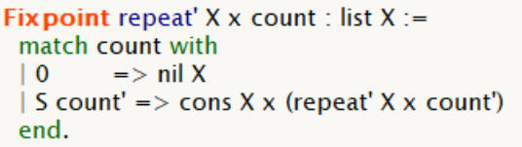
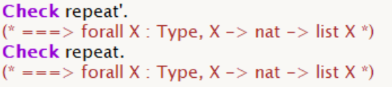
Type Annotation Inference
Not specifying the types of any of the arguments

Slide 21
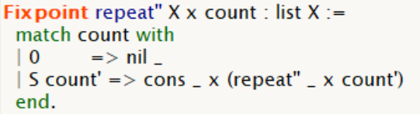

Type Argument Synthesis

